Slide 1
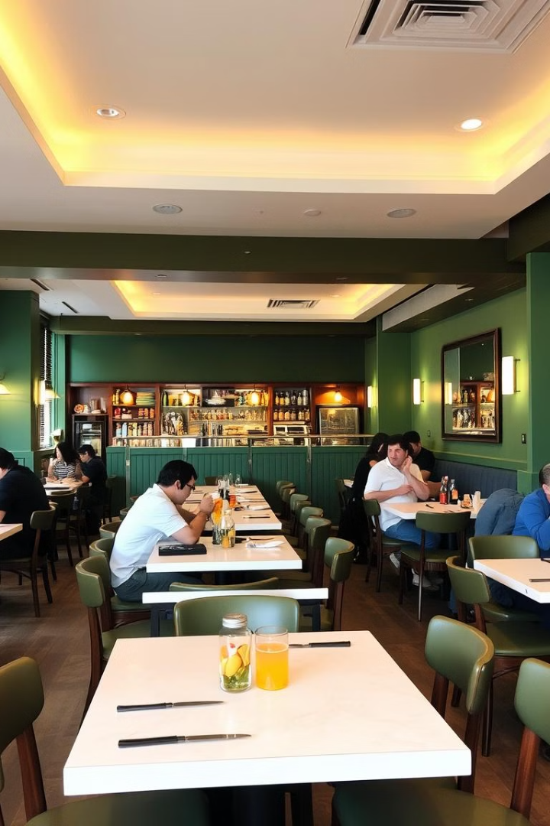
Restaurant Ordering System in C++
This presentation will guide you through the creation of a simple interactive restaurant ordering system using C++.

Slide 2
Defining the Menu and Prices
Menu Items
Prices Array
Pizza
7.99, 5.99, 4.99, 2.99, 1.99
Pasta
Steak
Fries
Drink

Slide 3
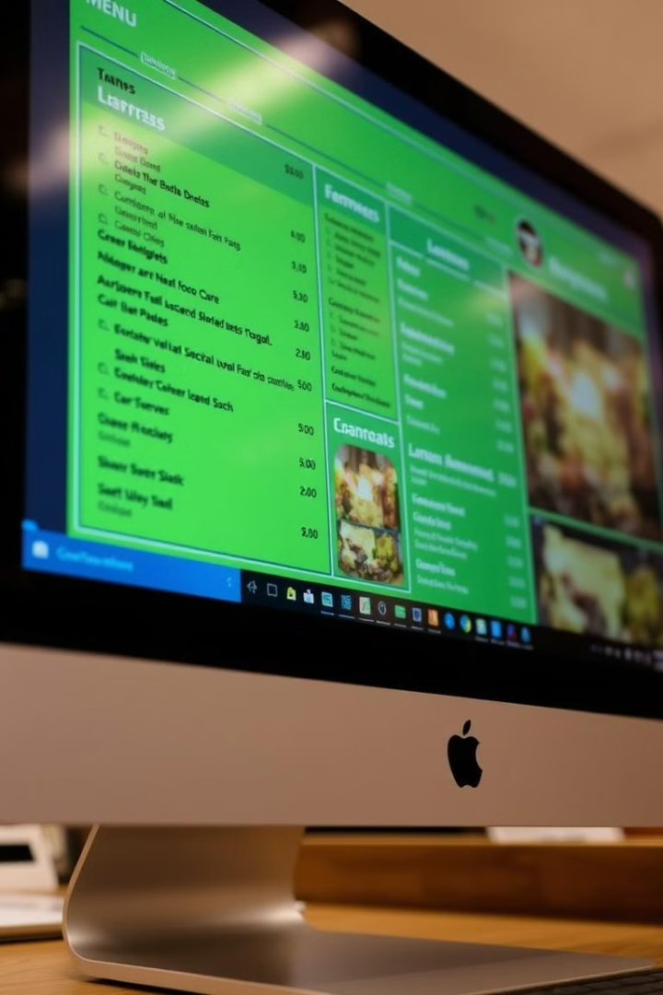
Displaying the Menu to the User
cout << "=====================================" << endl; cout << "Welcome to our cozy restaurant!" << endl; cout << "We're so glad you're here. Here's our menu:\n"; cout << "=====================================\n"; for (int i = 0; i < menuSize; i++) { cout << menuItems[i] << " - $" << fixed << setprecision(2) << prices[i] << endl; } cout << "=====================================\n";

Slide 4

Taking Customer Orders
Input
Validation
Item number (choice)
Check if the choice is within valid range (1-5)
Quantity of the item (quantity)
Ensure quantity is greater than 0

Slide 5
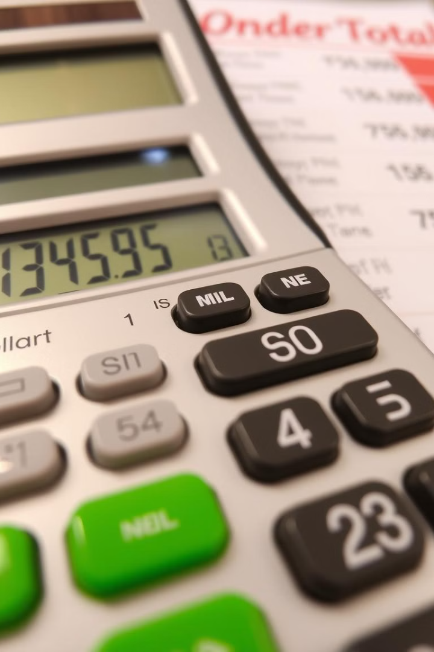
Calculating the Order Total
total += prices[choice - 1] * quantity;
1
Calculation
2
Continue Ordering
For each order, multiply price by quantity and add it to the running total.
Ask if the user wants to order more items (yes/no).

Slide 6




Calculating the Final Bill
float tax = total * taxRate; float finalTotal = total + tax;
Subtotal
Tax
Total
The accumulated total of all orders.
10% of the subtotal.
Subtotal + Tax.

Slide 7

Generating the Final Bill
cout << "\n=== BILL ===" << endl; cout << "Subtotal: $" << fixed << setprecision(2) << total << endl; cout << "Tax (10%): $" << fixed << setprecision(2) << tax << endl; cout << "Total: $" << fixed << setprecision(2) << finalTotal << endl; cout << "Thank you for dining with us!" << endl;

Slide 8
Full Program Code
#include #include #include using namespace std; int main() { string menuItems[] = {"1. Pizza", "2. Pasta", "3. Steak", "4. Fries", "5. Drink"}; float prices[] = {7.99, 5.99, 4.99, 2.99, 1.99}; const int menuSize = 5; float taxRate = 0.10; cout << "=====================================" << endl; cout << "Welcome to our cozy restaurant!" << endl; cout << "=====================================\n"; for (int i = 0; i < menuSize; i++) { cout << menuItems[i] << " - $" << fixed << setprecision(2) << prices[i] << endl; } int choice; int quantity; float total = 0.0; char continueOrdering; do { cout << "\nEnter item number (1-5): "; cin >> choice; if (choice < 1 || choice > menuSize) { cout << "Invalid choice! Please enter a number between 1 and 5.\n"; continue; } cout << "Enter quantity: "; cin >> quantity; if (quantity <= 0) { cout << "Invalid quantity! Must be greater than 0.\n"; continue; } total += prices[choice - 1] * quantity; cout << "Would you like to order more? (y/n): "; cin >> continueOrdering; } while (continueOrdering == 'y' || continueOrdering == 'Y'); float tax = total * taxRate; float finalTotal = total + tax; cout << "\n=== BILL ===\n"; cout << "Subtotal: $" << fixed << setprecision(2) << total << endl; cout << "Tax: $" << fixed << setprecision(2) << tax << endl; cout << "Total: $" << fixed << setprecision(2) << finalTotal << endl; cout << "Thank you for dining with us!" << endl; return 0; }

Slide 9




Conclusion
1
Features Recap
2
Menu display, order input, total calculation
3
Simple and user-friendly interface
4
Clear output for the final bill
This program provides a foundation for a restaurant ordering system. It can be enhanced with additional features like discounts, custom items, and more.

